Slide 1


DIYA Presentation
Team AUTOML members

Slide 2
Contents
1. Introduction
Why Neural Architecture Search?
1. Intro
2. NEAT
Machine Learning
3. DARTS
4. Exp
Deep Learning
Neural Architecture Search

Slide 3
Contents
1. Introduction
2 Ways of Neural Architecture Search
1. Intro
2. NEAT
Prune huge Networks
Find sub network and then make neural network
3. DARTS
4. Exp
Find sub network and then make neural network

Slide 4
Contents
1. Introduction
Papers that prove ‘Prune huge Networks’
1. Intro
2. NEAT
3. DARTS
‘The Lottery Ticket Hypothesis:
Finding Sparse, Trainable Neural Networks’
4. Exp

Slide 5
Contents
1. Introduction
What we learn from spring semester
1. Intro
2. NEAT
‘Prune huge Networks’ Weak Points
3. DARTS
4. Exp
Memory Problem
Dynamic Input

Slide 6
Contents
1. Introduction
What we learn from spring semester
1. Intro
2. NEAT
Result Analysis of Neural Network
3. DARTS
4. Exp
Node
Pattern

Slide 7
Contents
1. Introduction
‘Sub Network → Neural Network’
1. Intro
2. NEAT
RNN Controller
3. DARTS
4. Exp
Micro Search Space → Sub Network
Macro Search Space → Neural Network

Slide 8
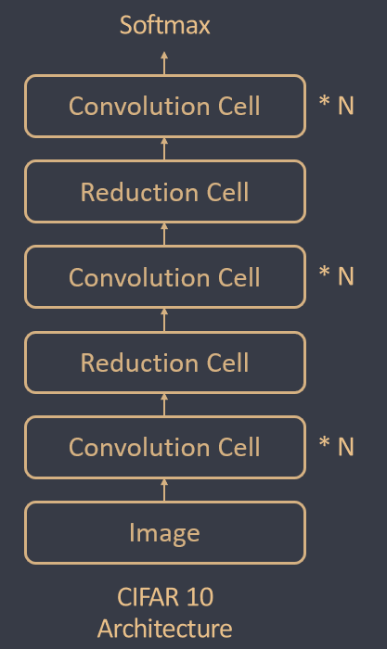
Contents
1. Introduction
Main Algorithm
1. Intro
2. NEAT
3. DARTS
4. Exp

Slide 9
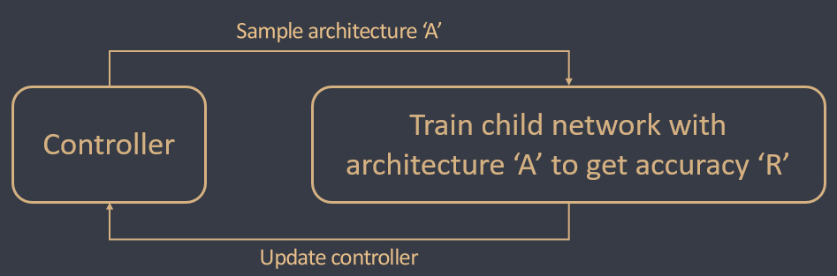
Contents
1. Introduction
Main Algorithm
1. Intro
2. NEAT
3. DARTS
4. Exp
Gradient Descent
Without GD

Slide 10
Contents
2. NEAT
About NEAT
1. Intro
2. NEAT
3. DARTS
Cell Design
Algorithm
4. Result

Slide 11
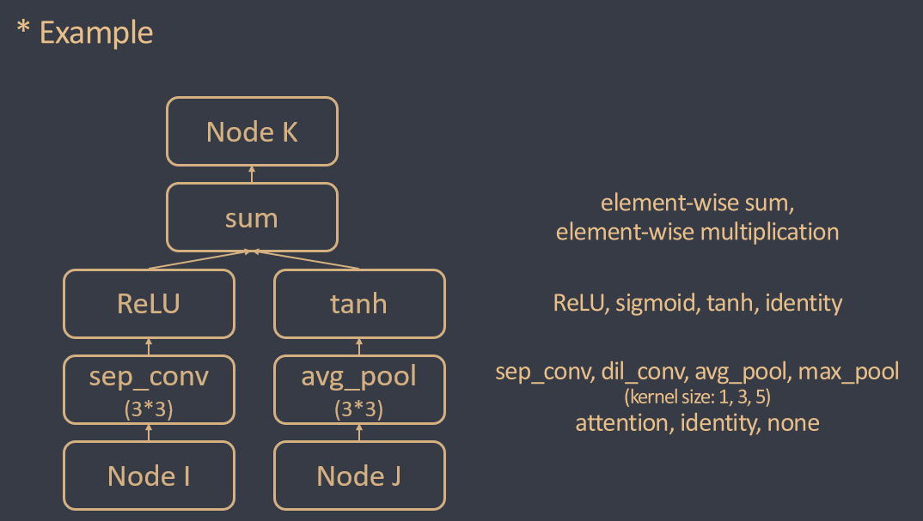
Contents
2. NEAT
NEAT Cell Design
1. Intro
2. NEAT
3. DARTS
4. Result

Slide 12
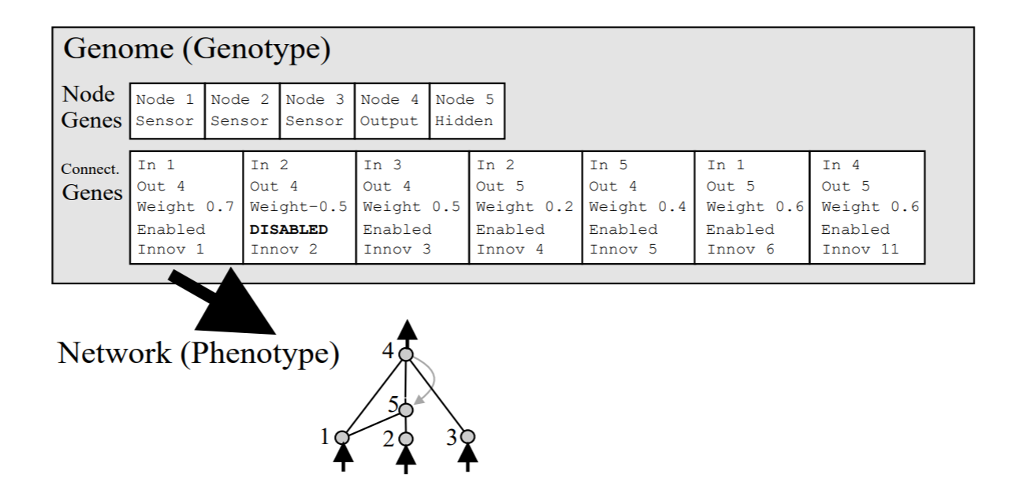
Contents
2. NEAT
NEAT Algorithm
1. Intro
2. NEAT
3. DARTS
4. Result

Slide 13
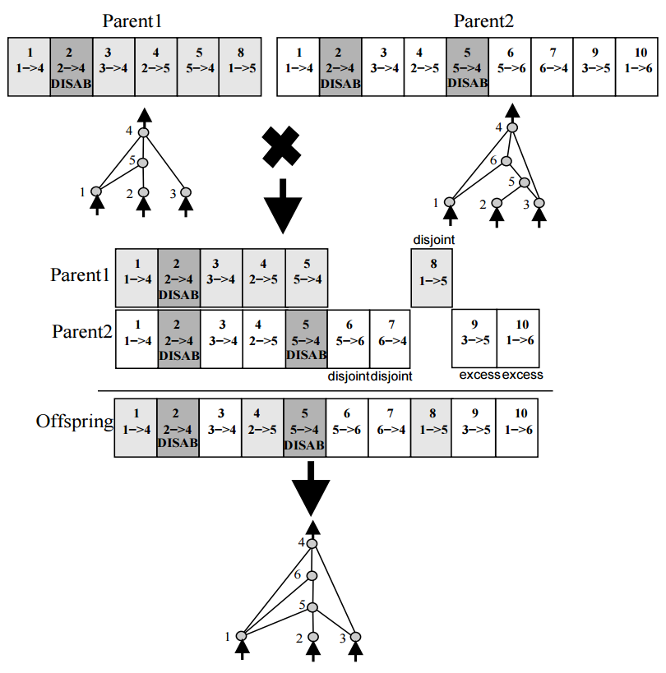
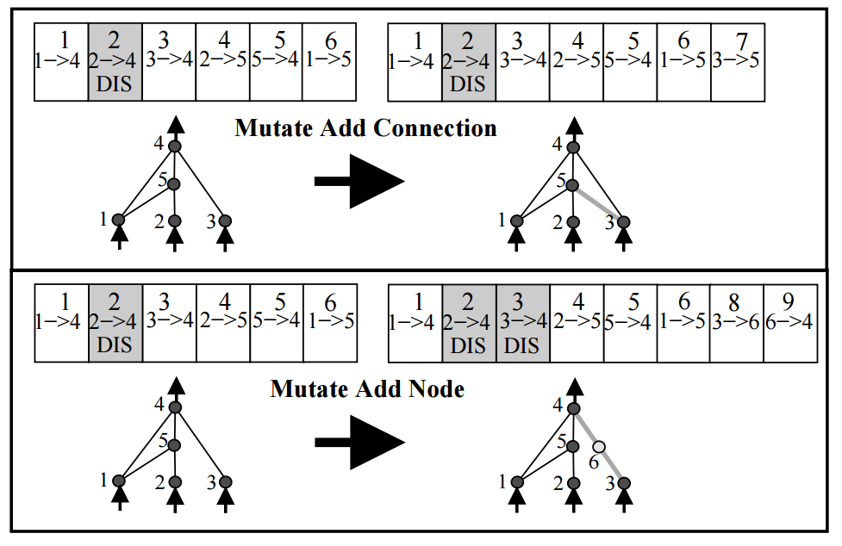
Contents
2. NEAT
NEAT Algorithm
1. Intro
2. NEAT
3. DARTS
4. Result

Slide 14
Contents
3. DARTS
About DARTS
1. Intro
2. NEAT
3. DARTS
Cell Design
Algorithm
4. Exp

Slide 15
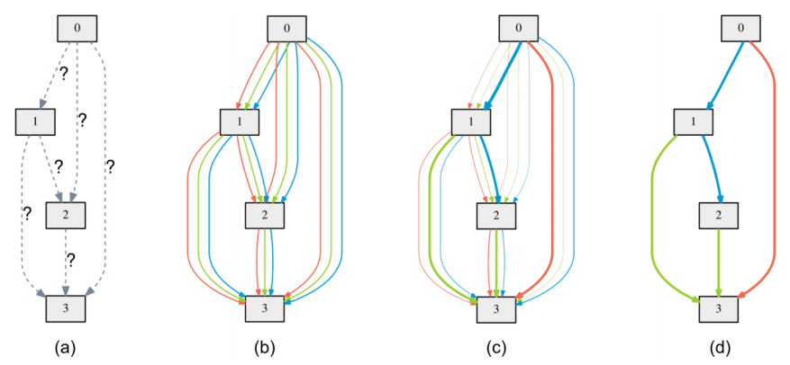
Contents
3. DARTS
DARTS Cell Design
1. Intro
2. NEAT
3. DARTS
4. Exp

Slide 16
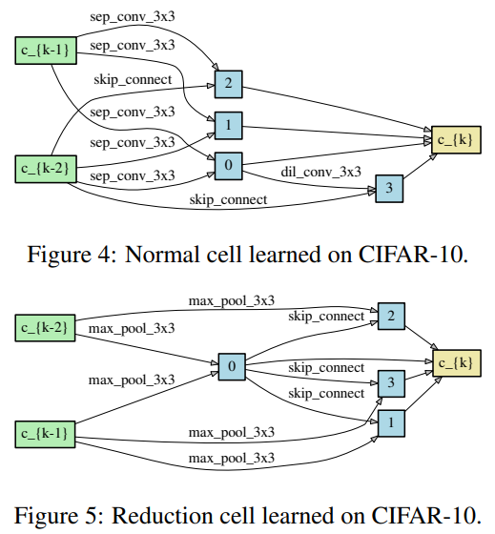
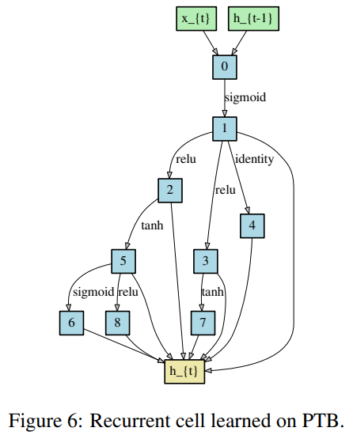
Contents
3. DARTS
DARTS Cell Design
1. Intro
2. NEAT
3. DARTS
4. Exp

Slide 17
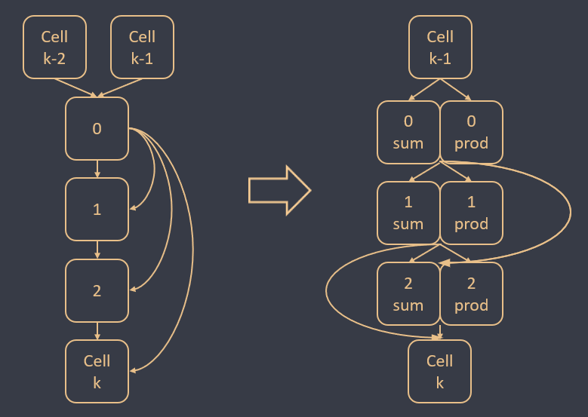
Contents
3. DARTS
DARTS Cell Design
1. Intro
2. NEAT
3. DARTS
4. Exp

Slide 18
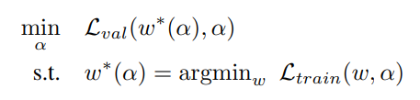
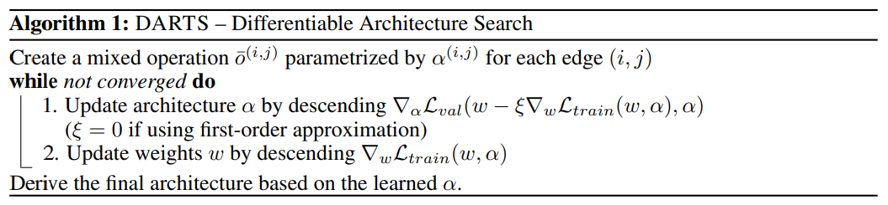
Contents
3. DARTS
DARTS Algorithm
1. Intro
2. NEAT
3. DARTS
4. Exp

Slide 19
Contents
4. Experiment
About Experiment
1. Intro
2. NEAT
Image dataset: MNIST
NLP dataset: SST-2
3. DARTS
4. Exp
Baseline
(ResNet18, Transformer)
DARTS
NEAT

Slide 20
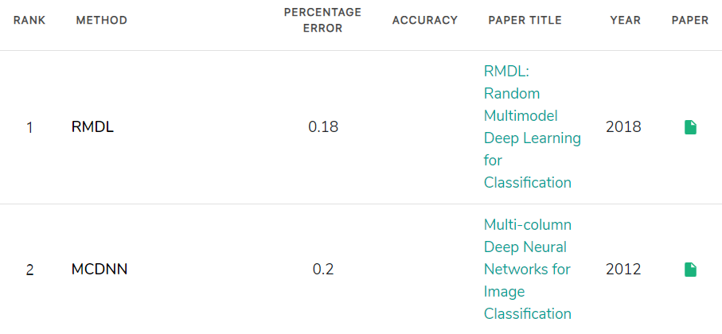
Contents
4. Experiment
Papers with code
1. Intro
2. NEAT
3. DARTS
4. Exp

Slide 21
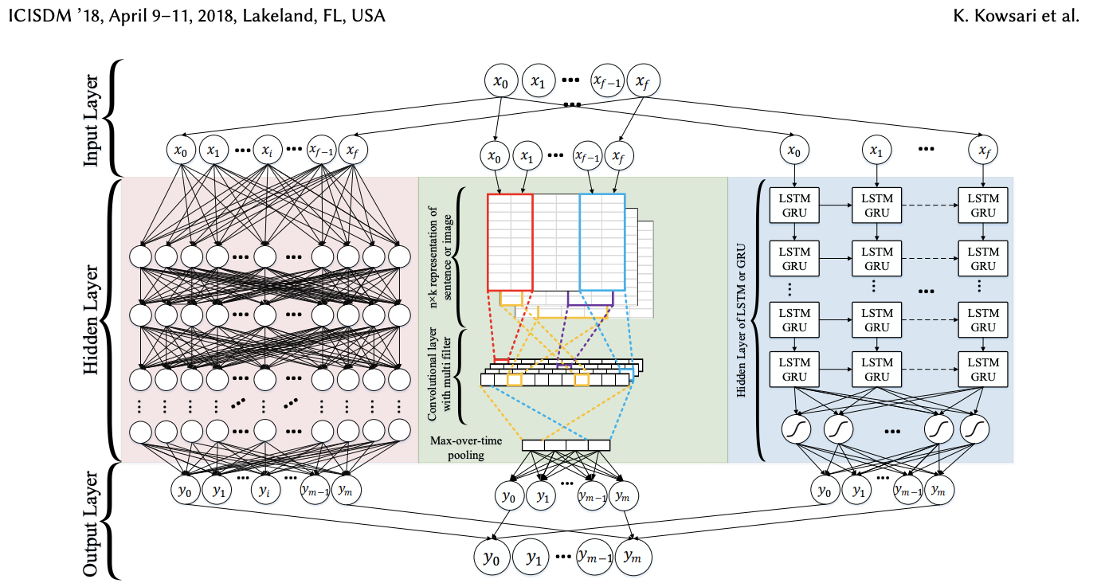
Contents
4. Experiment
MNIST state of the art
RMDL : Random Multimodel Deep Learning for Classification
1. Intro
2. NEAT
DNN, CNN, RNN majority voting 앙상블
레이어 수는 랜덤하게 생성
Accuracy : 99.82%
Baseline Accuracy : 98.94%
3. DARTS
4. Exp

Slide 22
Contents
4. Experiment
SST-2 state of the art
1. Intro
Exploring the Limits of Transfer Learning
with a Unified Text-to-Text Transformer
2. NEAT
SST-2 뿐만 아니라 Web에서 Common Crawl한 dataset도 사용
Dataset에 scaling과 transfer approach들을 사용함
Task-specific prefix를 original input에 더하여 사용함
Accuracy : 97.4%
Baseline Accuracy : 78.17%
3. DARTS
4. Exp

Slide 23
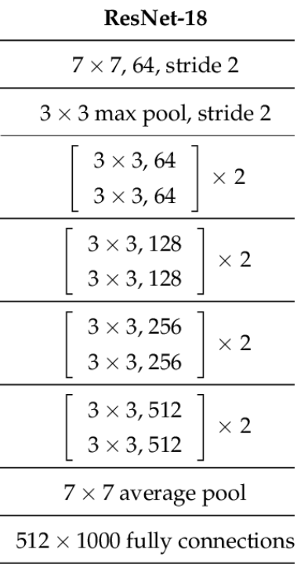
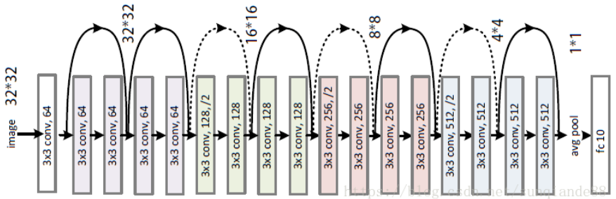
Contents
4. Experiment
Baseline Image dataset: ResNet18
1. Intro
2. NEAT
3. DARTS
4. Exp

Slide 24
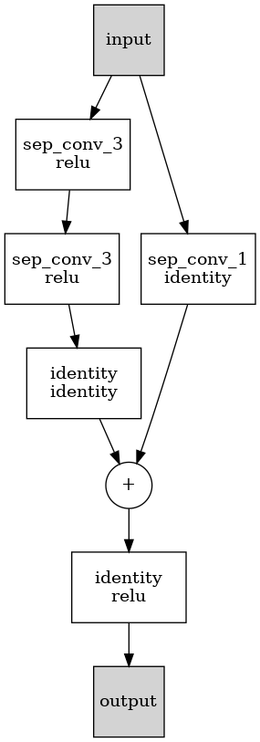
Contents
4. Experiment
Baseline Image dataset: ResNet18
1. Intro
2. NEAT
3. DARTS
4. Exp

Slide 25
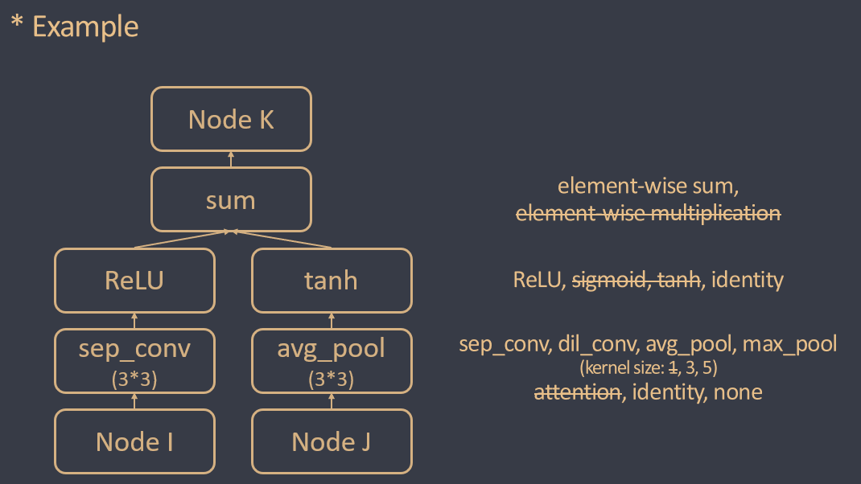
Contents
4. Experiment
Operations Used
1. Intro
2. NEAT
3. DARTS
4. Exp

Slide 26
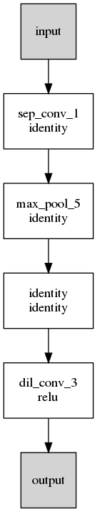
Contents
4. Experiment
NEAT
1. Intro
2. NEAT
3. DARTS
4. Exp

Slide 27
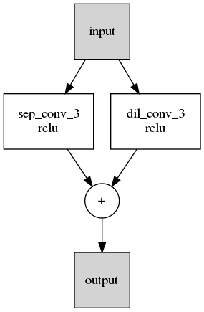
Contents
4. Experiment
DARTS
1. Intro
2. NEAT
3. DARTS
4. Exp

Slide 28
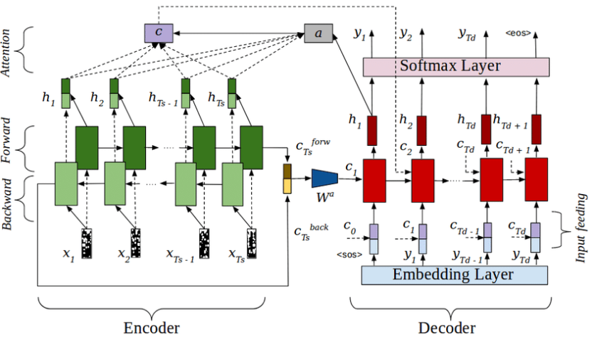
Contents
4. Experiment
Baseline NLP dataset: Transformer
1. Intro
2. NEAT
3. DARTS
4. Exp

Slide 29
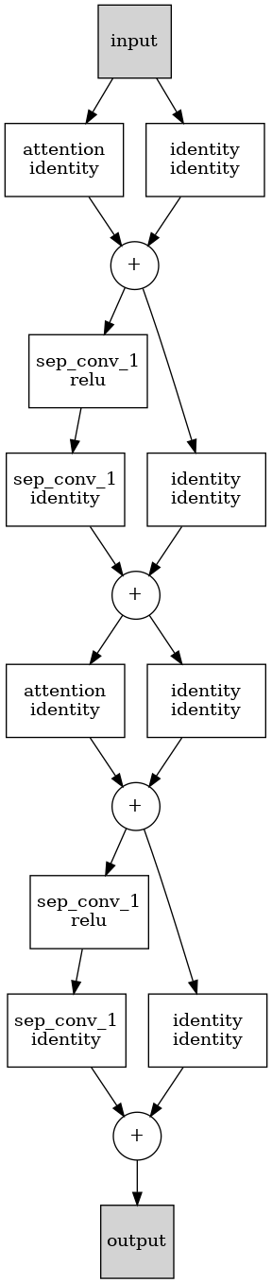
Contents
4. Experiment
Baseline NLP dataset: Transformer
1. Intro
2. NEAT
3. DARTS
4. Exp

Slide 30

Contents
4. Experiment
Operations Used
1. Intro
2. NEAT
3. DARTS
4. Exp

Slide 31
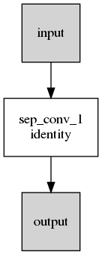
Contents
4. Experiment
NEAT
1. Intro
2. NEAT
3. DARTS
4. Exp

Slide 32
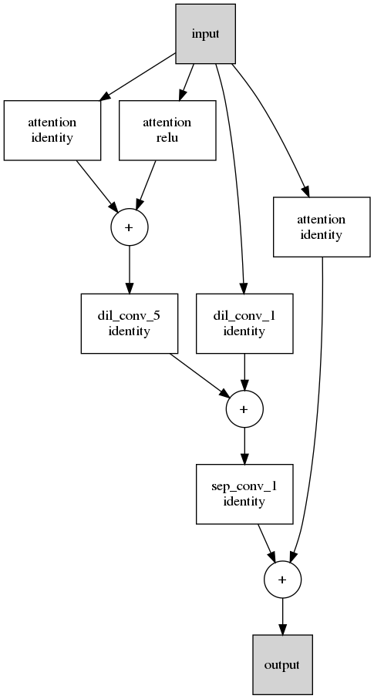
Contents
4. Experiment
DARTS
1. Intro
2. NEAT
3. DARTS
4. Exp

Slide 33
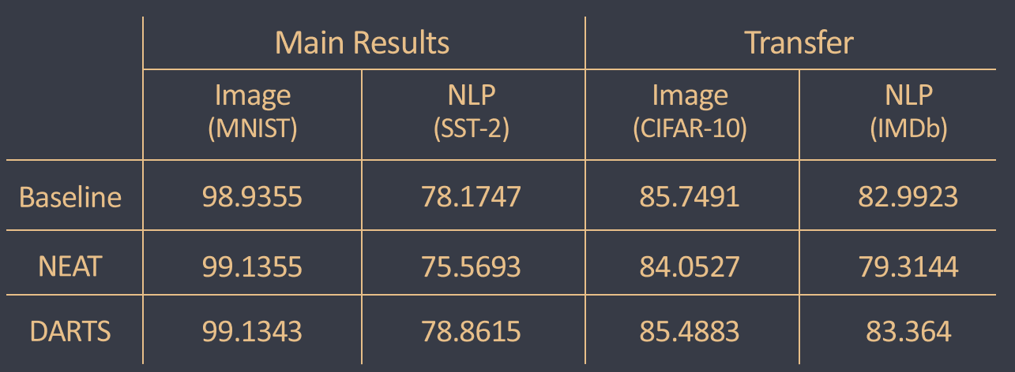
Contents
4. Experiment
Result Compared
1. Intro
2. NEAT
3. DARTS
4. Exp

Slide 34
Contents
1. Intro
2. NEAT
Thanks for listening
3. DARTS
4. Exp

Slide 35
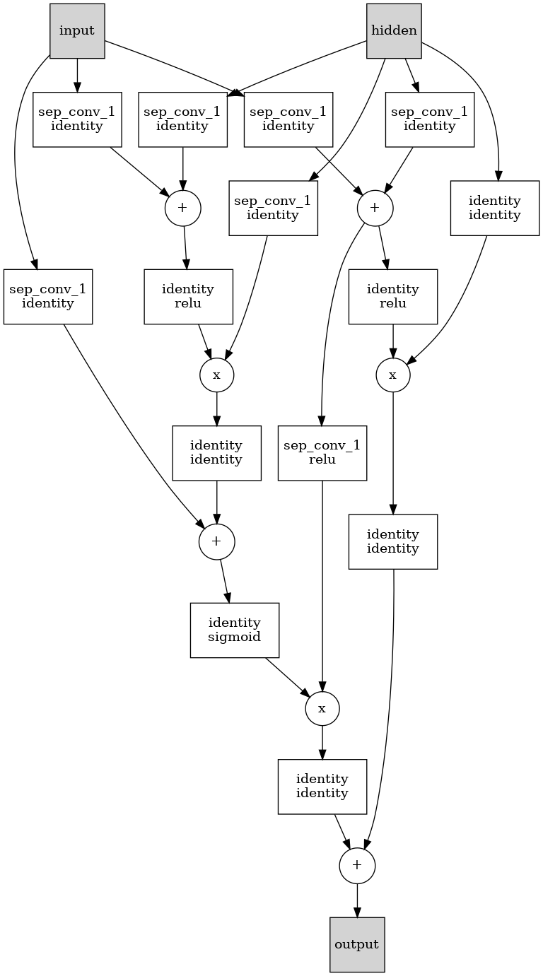
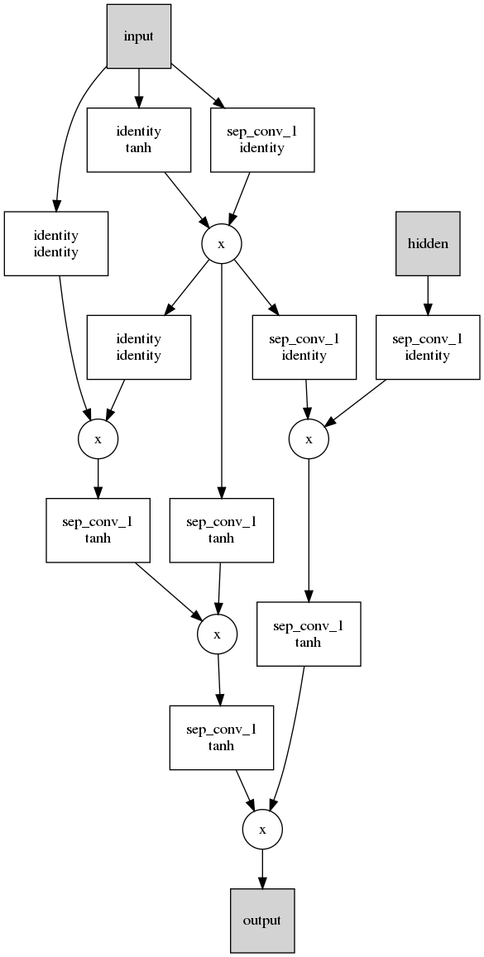
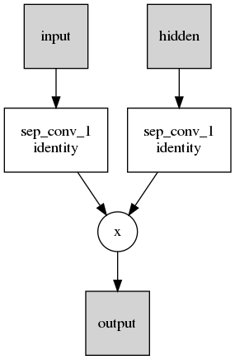
Contents
Q & A
1. Intro
2. NEAT
3. DARTS
4. Exp
NEAT
Baseline
DARTS

Slide 36
Resources

Slide 37
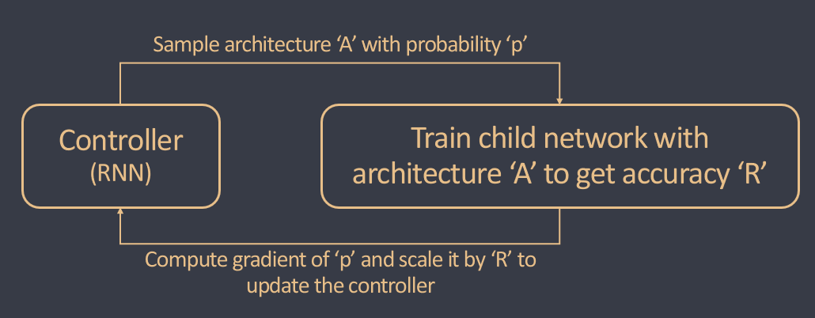
Sample architecture ‘A’
Controller
Train child network with
architecture ‘A’ to get accuracy ‘R’
Update controller

Slide 38
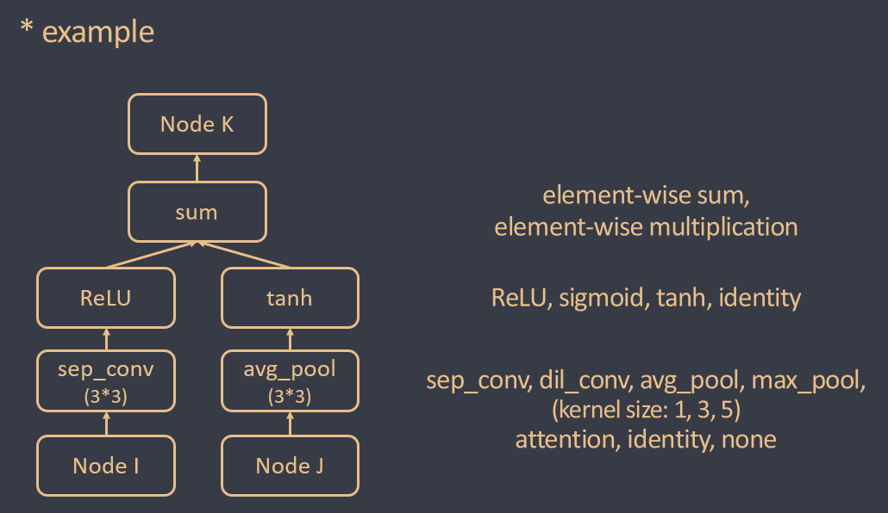
* Example
Node K
sum
element-wise sum,
element-wise multiplication
ReLU
tanh
ReLU, sigmoid, tanh, identity
sep_conv
(3*3)
avg_pool
(3*3)
sep_conv, dil_conv, avg_pool, max_pool
(kernel size: 1, 3, 5)
attention, identity, none
Node I
Node J

Slide 39
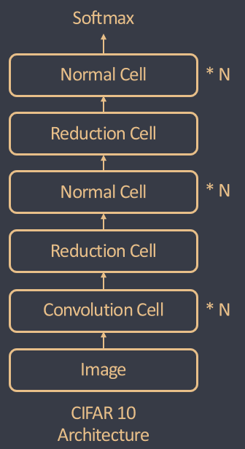
Softmax
Convolution Cell
* N
Reduction Cell
Convolution Cell
* N
Reduction Cell
Convolution Cell
* N
Image
CIFAR 10
Architecture

Slide 40
 | Main results |  | Transfer
 | CNN (MNIST) | Transformer (SST-2) | CNN (CIFAR-10) | Transformer (IMDb)
Baseline | 98.9355 | 78.1747 | 85.7491 | 82.9923
NEAT | 99.1355 | 75.5693 | 84.0527 | 79.3144
DARTS | 99.1343 | 78.8515 | 85.4883 | 83.364
Main Results
Transfer
Image
(MNIST)
NLP
(SST-2)
Image
(CIFAR-10)
NLP
(IMDb)
Baseline
98.9355
78.1747
85.7491
82.9923
NEAT
99.1355
75.5693
84.0527
79.3144
DARTS
99.1343
78.8615
85.4883
83.364

